Slide 1

CAPSTONE PROJECT AMAZON PRODUCT REVIEW ANALYSIS
BY:
AAKASH
RAKESH
SUNIL PATIL

Slide 2




OBJECTIVE
01
02
03
04
Customer Retention
Finding Product names
Sentiment
Forecasting
Inter-Category Analysis

Slide 3




DATA PRE-PROCESSING METHODOLOGY
Data Pre-Analysis
Data Conversion
Data Selection
Data Download
Data Cleaning
Data Representation
3
2
4
1
5
6

Slide 4
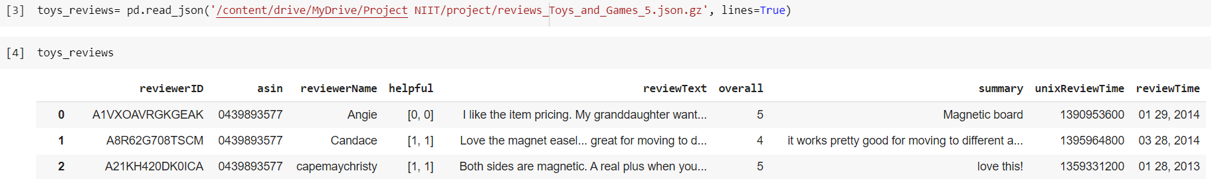
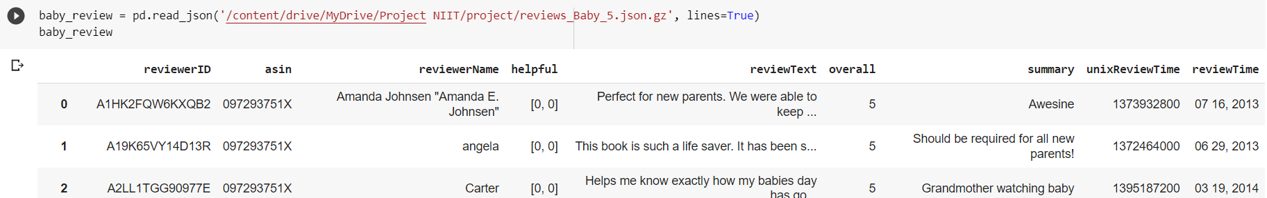
DATA DOWNLOAD
Data download Source: http://jmcauley.ucsd.edu/data/amazon/
Data reading:
Tableau
Visualization
Toys and Games Dataset
Toys & Games | Tableau Public
Baby Dataset
Baby| Tableau Public

Slide 5
DATA PRE-ANALYSIS
Understanding the data and data size Toys & games: 1,67,597 of reviews Baby: 1,60,792 of reviews
Conversion of pd.DataFrame to .csv file (final data)

Slide 6

PROBLEM STATEMENT:- 1
Based on the ‘review text’ and ‘summary’ of the data, identify how a review can be classified into a particular category. How this will help in the customer retention?

Slide 7
METHODOLOGY: Sentiment Analysis
.
4
5
3
2
1
Data collection
Text preparation
Sentiment Detection
Sentiment Classification
Presentation of Output

Slide 8

DATA OPTIMIZATION & TEXT CLEANING
Concatenation of ’review text’ and ’summary’
Concatenate Review and Summary columns as ‘reviewtext’ column
NLP Pipeline
Cleaning
Tokenization
Stopwords removal
Lemmatization

Slide 9
SENTIMENT ANALYSIS
VADER (Valence Aware Dictionary for Sentiment Reasoning) is an NLTK module that provides sentiment scores based on the words used.
It relies on a dictionary that maps lexical features to emotion intensities known as sentiment scores.
Review Text (Input) | Sentiment Scores (Output) | Sentiments (Output)
love magnet easel great move different areas wish sort non skid pad bottom though work pretty good move different areas | 0.9545 | Extreme Positive
far grand son really like start crawl follow toy around room learn toy | 0.6997 | Positive
wait could get sale cant wait fall use december year old cant wait use | 0 | Neutral
ok price could get much larger shoe local toy store tiny really disappoint small | -0.2006 | Negative
crappy cardboard ghost original hard believe shame hasbro disgust | -0.9719 | Extreme Negative

Slide 10
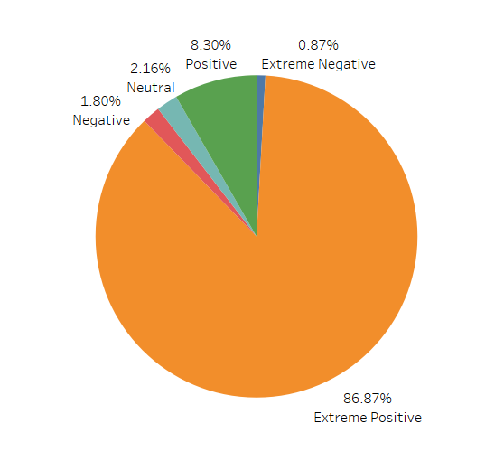
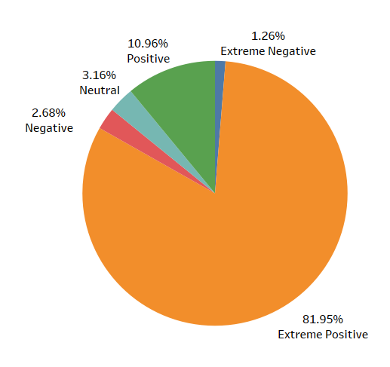
OVERALL SENTIMENT RESULTS
Toys & Games
Sentiments (Output) | Reviews count
Extreme Positive | 1,44,747
Positive | 13,856
Neutral | 3,606
Negative | 3,004
Extreme Negative | 1,453
Baby
Sentiments (Output) | Reviews count
Extreme Positive | 1,30,538
Positive | 17,494
Neutral | 5,045
Negative | 4,282
Extreme Negative | 2,008

Slide 11
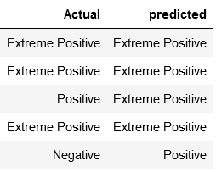
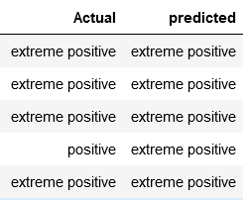
CLASSIFICATION USING MACHINE LEARNING
Model – Logistic regression cv
‘Toys & Games’ Dataset
‘Baby’ Dataset
Accuracy of the model : 91.16%
Accuracy of the model : 88.20%

Slide 12
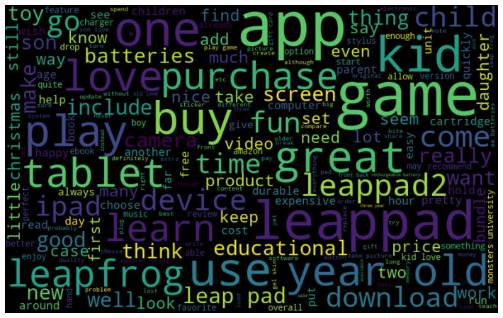
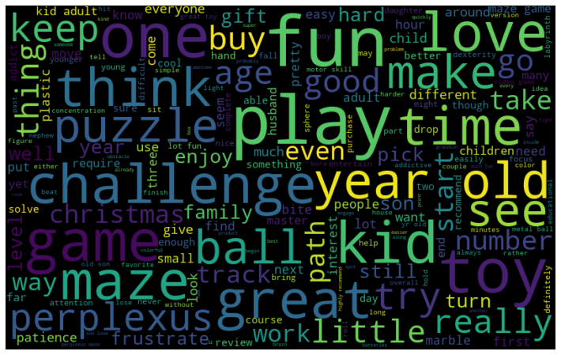
Word cloud of Positive Sentiments (Baby Dataset)
Product id: B0089RPUHO
Product id: B002NPBT50

Slide 13
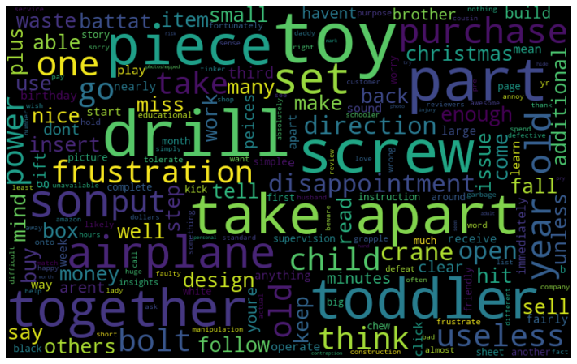
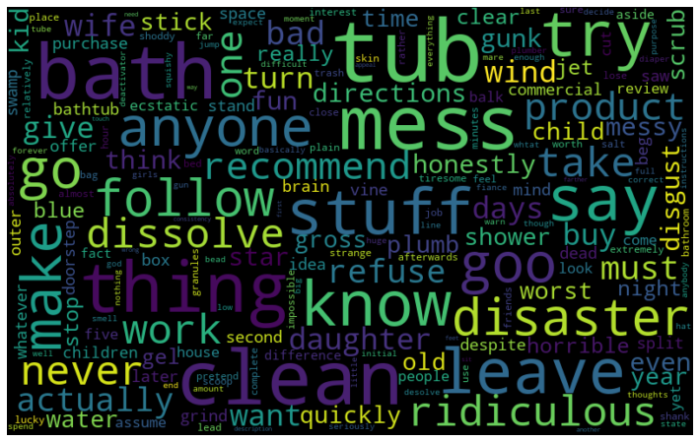
Word cloud of Negative Sentiments (Baby Dataset)
Product id: B000N5QNSK
Product id: B001W9AM1K

Slide 14
PROBLEM STATEMENT:- 2
Identify the name of negative products by analyzing your input text data and find out the reason behind it. Suggest a strategy to overcome this?

Slide 15
Products needing attention: Negative Reviews Toys and Games Dataset
Product Id | Product Name | Sentiment Score | Word
B0002717BW | Butterfly Punk Barbie doll | -0.771 | Idiotic
B004U52VPS | Angry Birds: Knock On Wood Game | -0.946 | Crap
B002VBXPPI | Gun, CS-6 Dart Blaster | -0.970 | Noisy, Slow
048645195X | Dover Publications Tile Designs Coloring Book | -0.743 | Bore, Bad
B000VSAEYI | Pool, Ocean Play Center | -0.938 | Dirty, Bad air quality

Slide 16
Products needing attention: Negative Reviews Baby Dataset
Product Id | Product Name | Sentiment Score | Word
B000056JEG | Medela CSF Bags | -0.775 | Expensive
B004CL9YHS | Gate | -0.822 | Poor quality
B001G2K2BI | Philips AVENT BPA Free Infant Bottle | -0.913 | Inaccurate scale
B003EUEUVS | Wall sticker | -0.700 | Terrible, adhere problem
B00003TL7P | Diaper | -0.790 | Smell really bad, never allow odors escape

Slide 17
PROBLEM STATEMENT:- 3
Trend and Seasonality analysis to predict how frequently a particular category of customer would shop in the future(Time Series Analysis)
METHODOLOGY: Time Series Analysis
Check for Trend and Seasonality
Build the ARIMAX model as there is no seasonal component

Slide 18
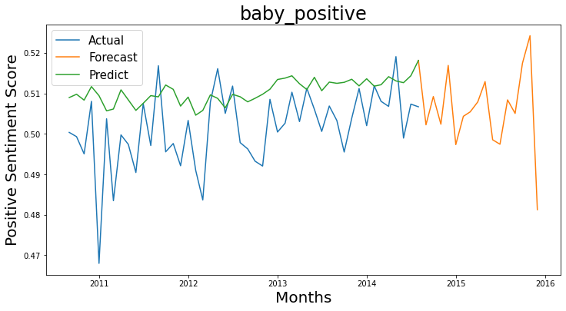
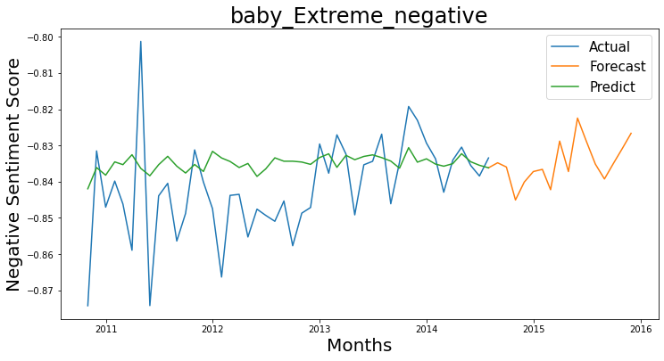
Time Series Forecasting: Positive and Negative Reviews for Baby Dataset

Slide 19
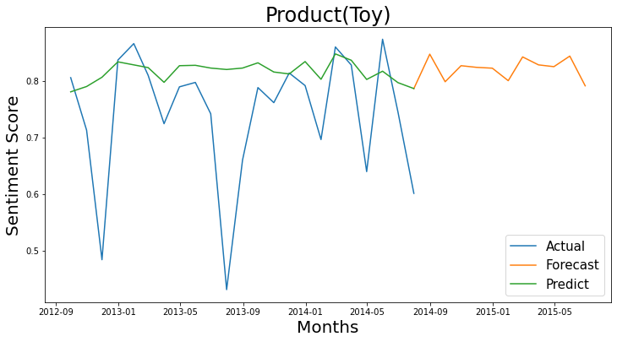
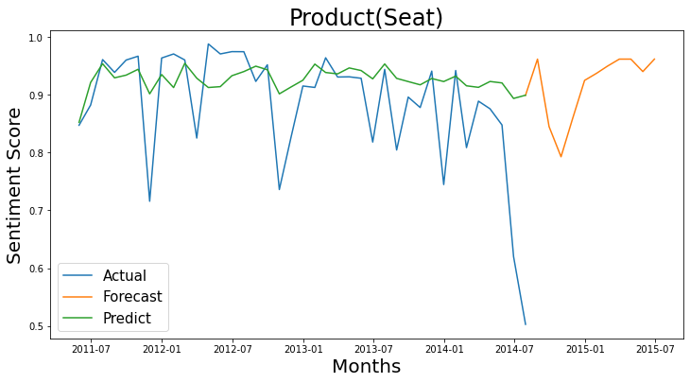
Time Series Forecasting : Baby products

Slide 20
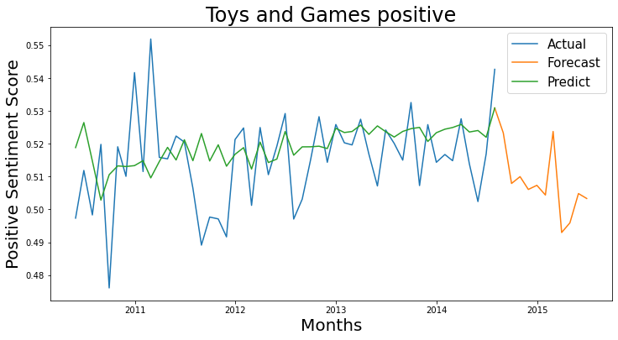
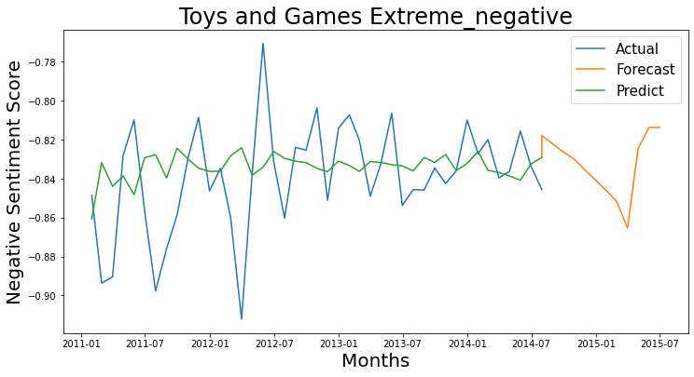
Time Series Forecasting: Positive and Negative Reviews for Toys and Games Dataset

Slide 21
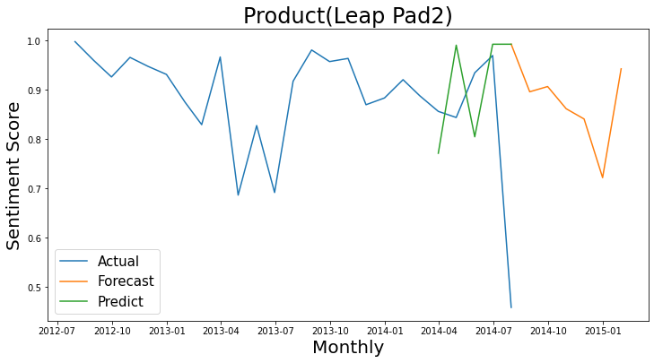
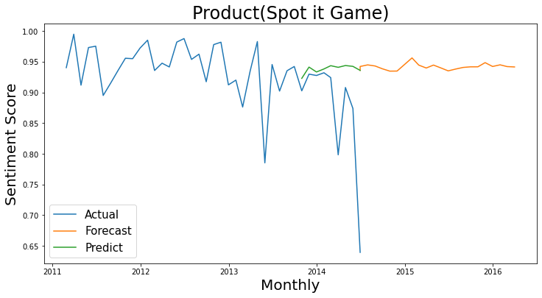
Time Series Forecasting : Toys and Games products

Slide 22
PROBLEM STATEMENT:- 4
Can you find any relations/trends of customers or any other interesting analysis between given pair of categories
The analysis between given pair of categories was done with the help of Tableau
Click the below link to switch to tableau:
Inter Category Analysis | Tableau Public

Slide 23
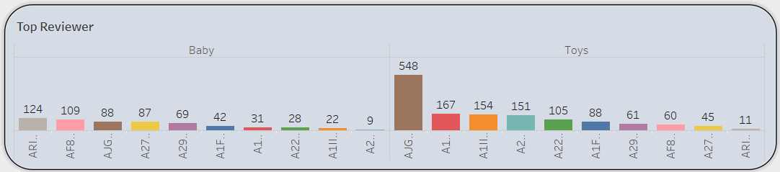
INTER-CATEGORY ANALYSIS
The top reviewer in toys has purchased 548 products also the same customer has purchased only 88 products in baby. So, we can suggest more products of baby to the customer.

Slide 24
CONCLUSION
Positive Reviews Customers
148032
Majority of the customer belongs to this segment.
Maximum sales and reviews.
Continue current retention strategies
3 percent of Amazon buyers depend on product reviews for purchasing
Offer discounts, coupons etc.
Customer survey in order to know problem areas
Replace products
Personalize communications and offers
Neutral Reviews Customers
5045
Negative Reviews Customers
6290
Thank the customer for their time, apologize, and offer to make it right
Offer discounts on next purchase or cost-free replacement of the product
Contact the partner/vendor organization with the feedback on products
Change the partner if quality is compromised

Slide 25
CONT…
Packaging
no bad reviews on packaging : Damaged, broken, opened
Logistics(Delivery)
no bad reviews on Logistics:
Delayed, time, late
Cost
bad reviews on Cost:
Expensive, costly
Product and Quality
Words like: Shape, dirty, crappy,
Smelly, inaccurate scale

Slide 26
THANK YOU

